Slide 1
Intro to Linux
Raffu Khondaker

Slide 2
What we’ll go over...
What is linux?
Windows vs Linux
Software Updates
File systems
Users/Root
Command Line

Slide 3

What is Linux?
Group of Unix-based operating systems
Open source
Kernel
Distributions
Arch Linux
Ubuntu
Debian
Fedora

Slide 4
Windows vs Linux
Linux
Open source
Distributions
Graphical User Interface (GUI) can be changed on Linux
Less Malware
Hardware compatibility
User types
File structure
Both
Used as server and workstation
Similar applications
Similar vulnerabilities

Slide 5
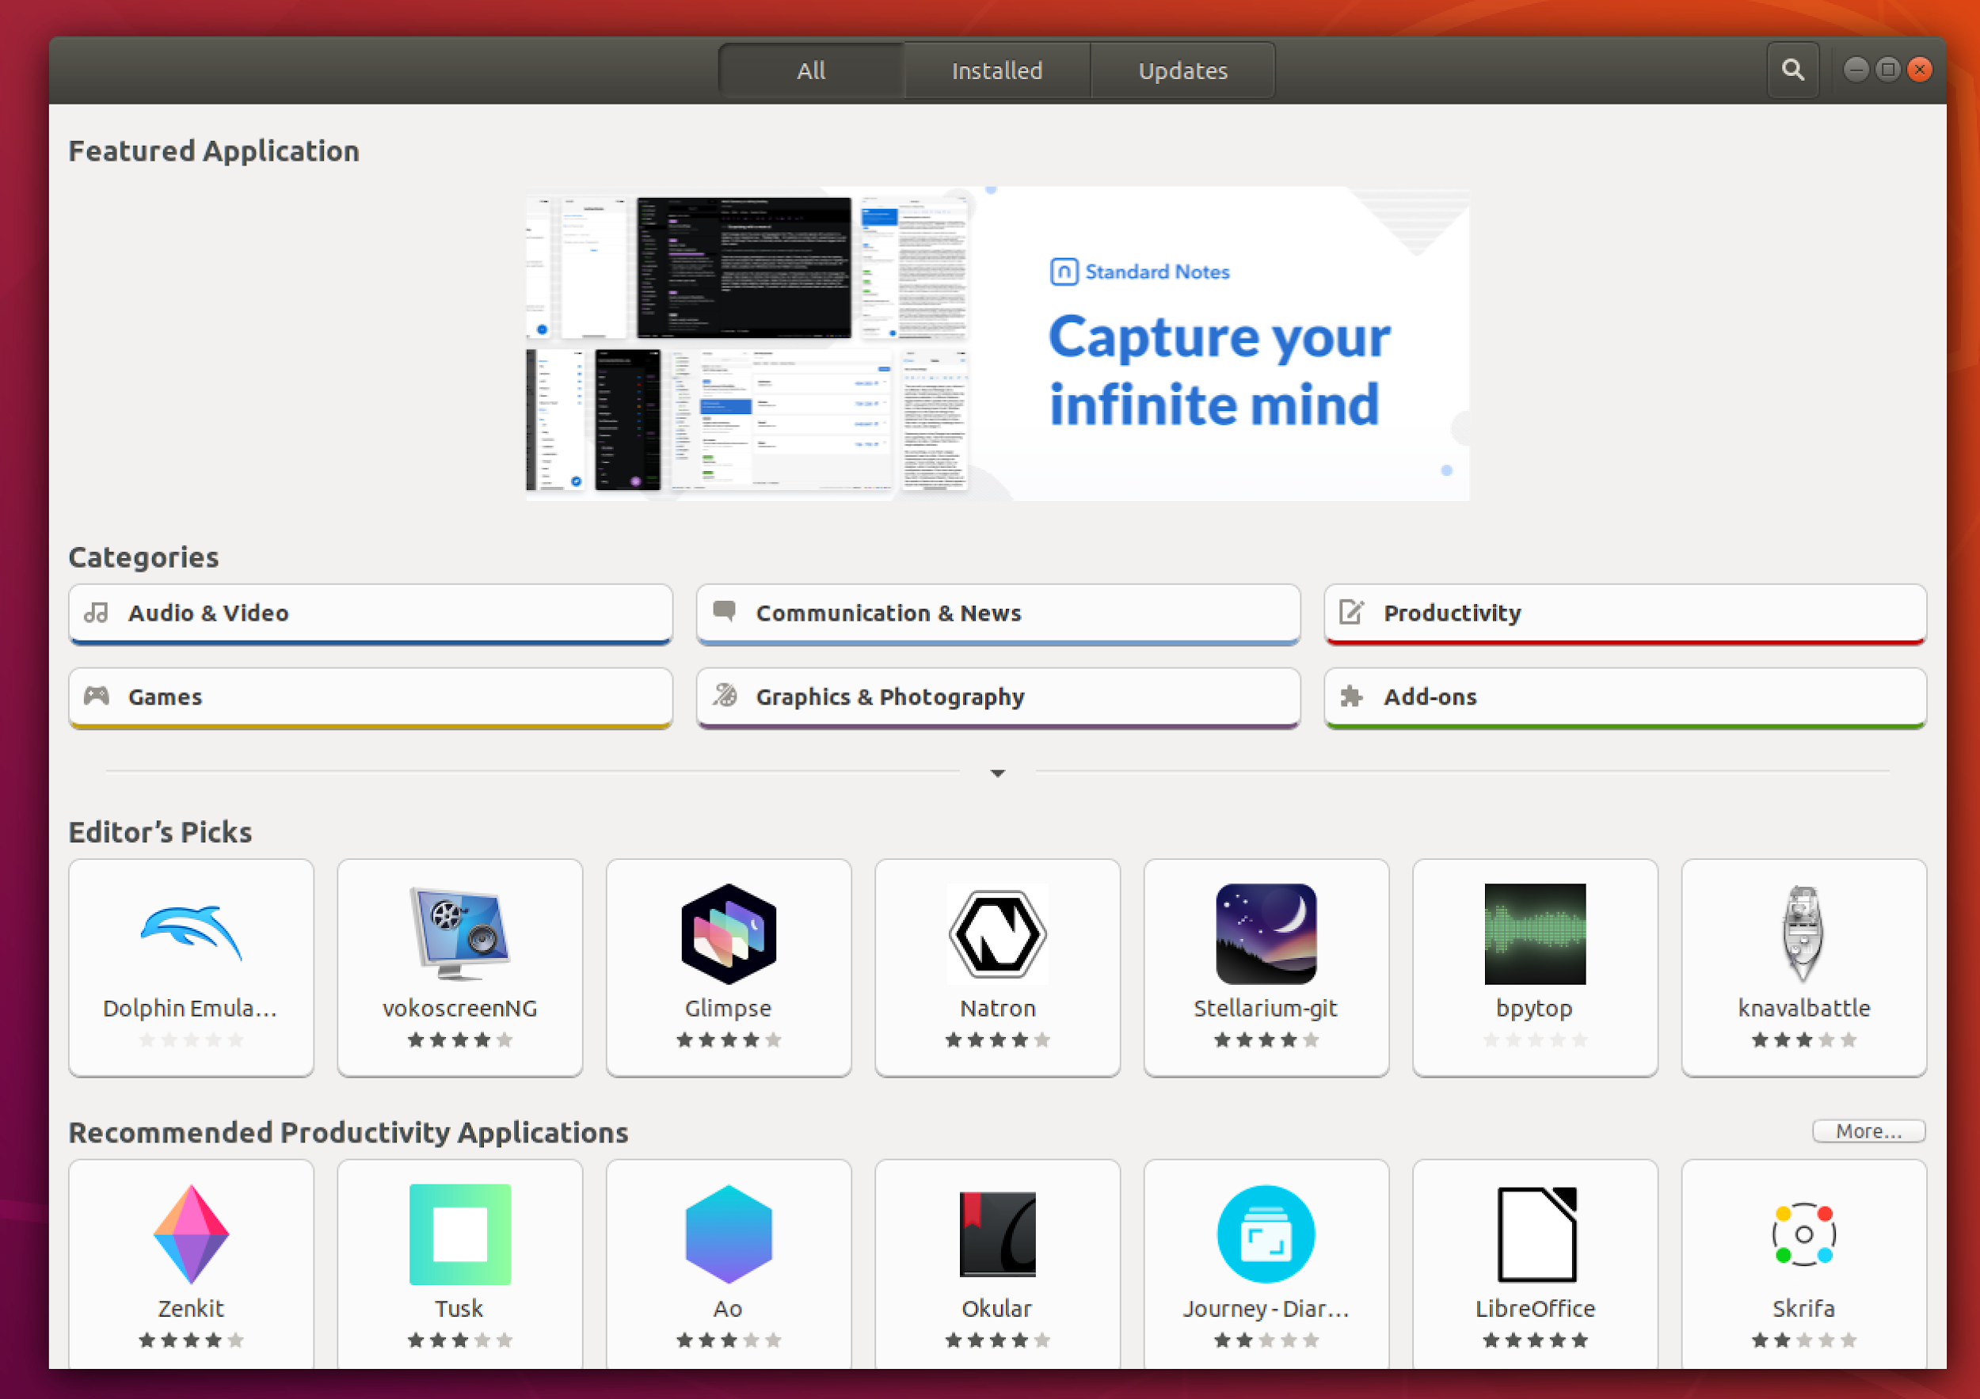

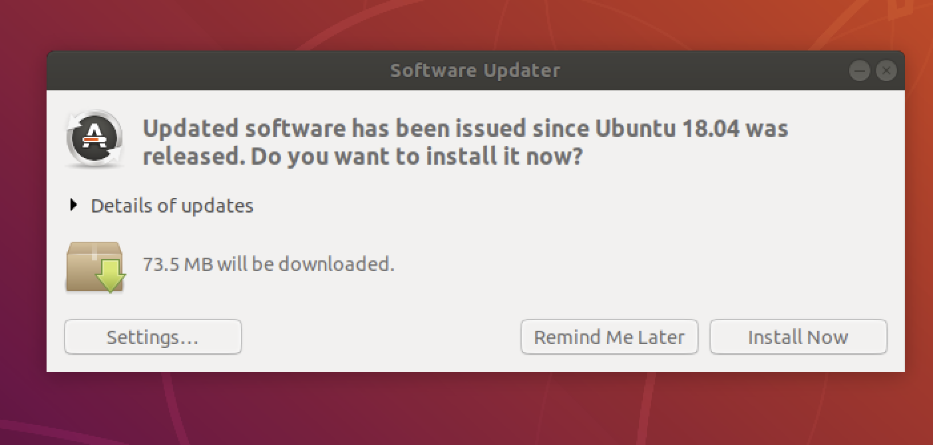
Software Updates
Packages: Software bundles
Can take a long time
install/update/config/remove through Package Manager
Ubuntu (GUI): Software Center
Command-line: apt, dpkg
Must be in root (authenticated)
Notes:
https://docs.google.com/document/d/1FvBk8Kuh0P42LGRxihjducVipcnYqMWaXIc7vQYe2jQ/edit?usp=sharing

Slide 6
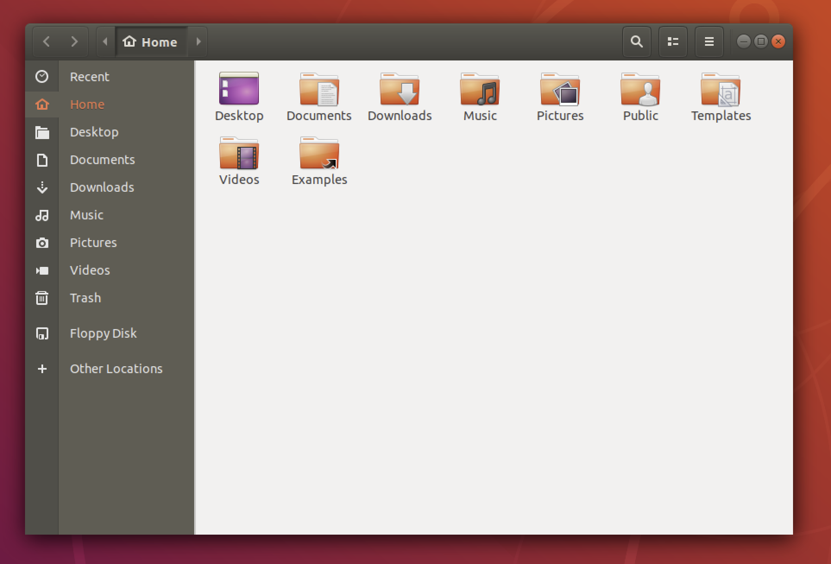
File system
Tree structure
/home/Documents/file.txt
“/” ⇐ root directory
Important folders:
/home - user-specific files (Documents, media)
/boot - static boot files
Don’t break anything
/etc - configuration files
/lib - essential libraries

Slide 7
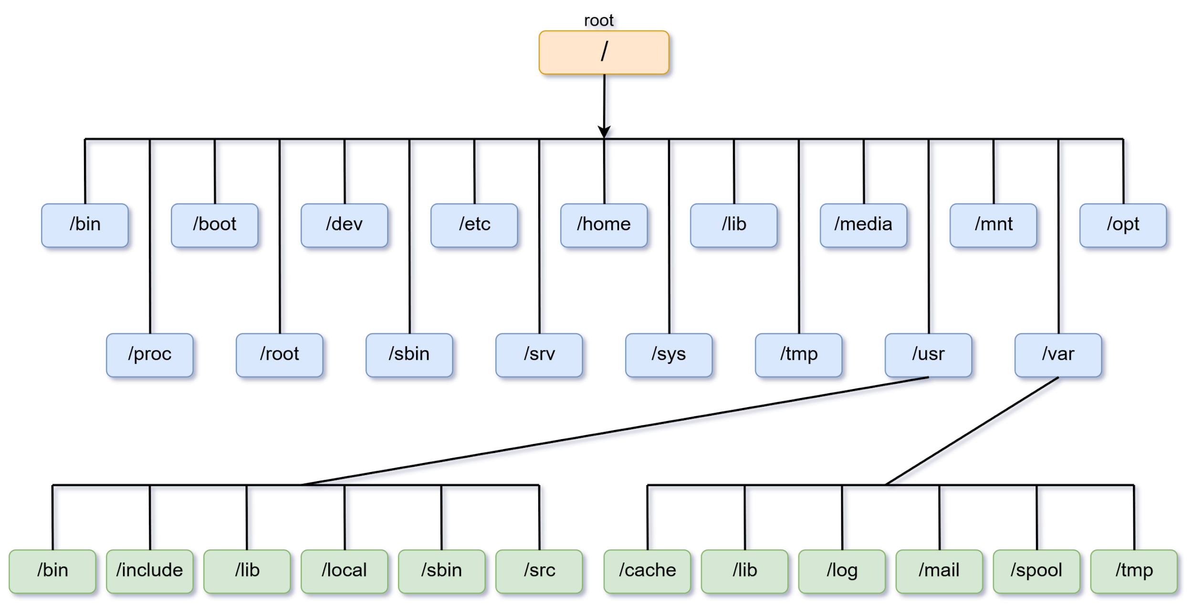

Slide 8
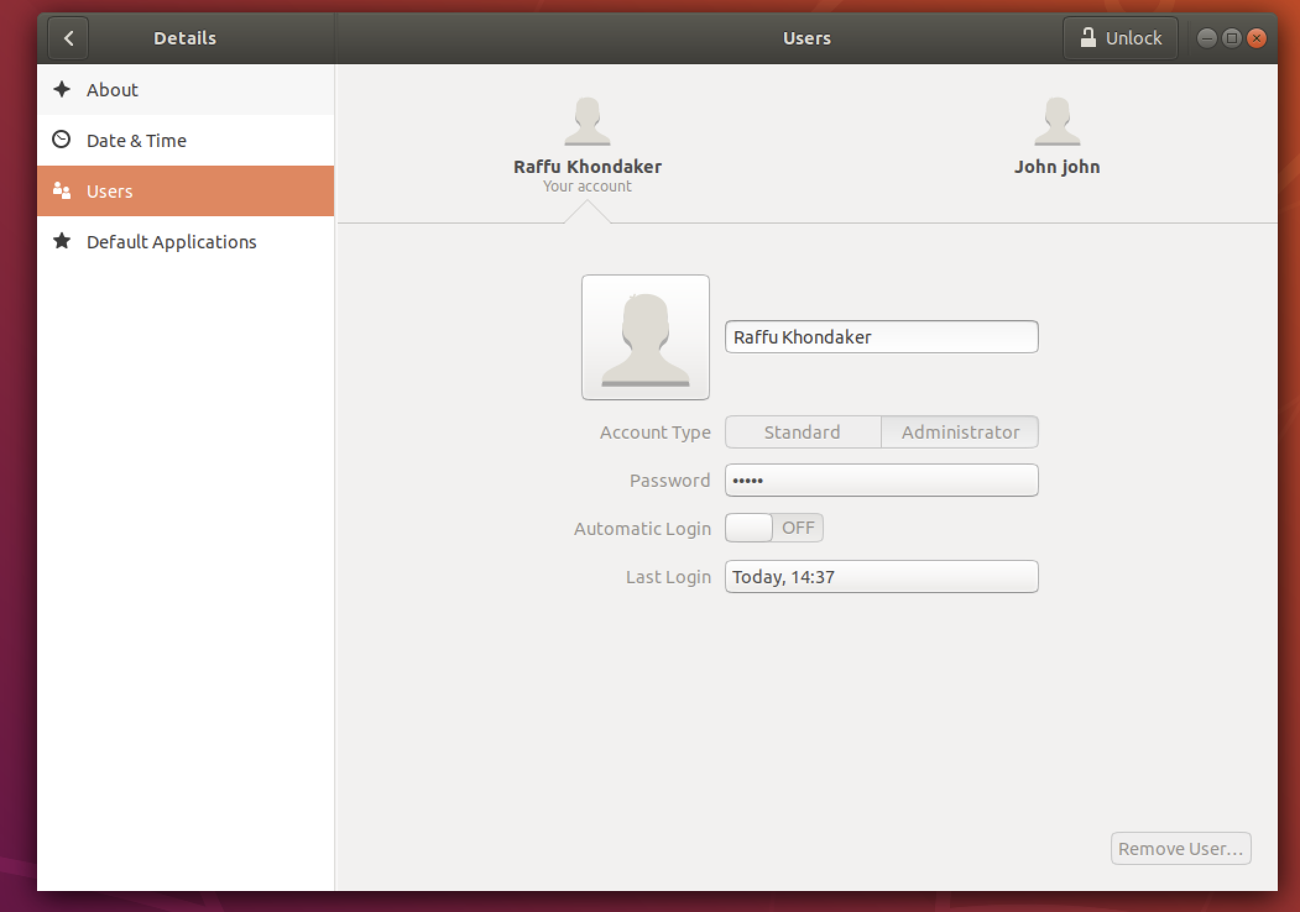
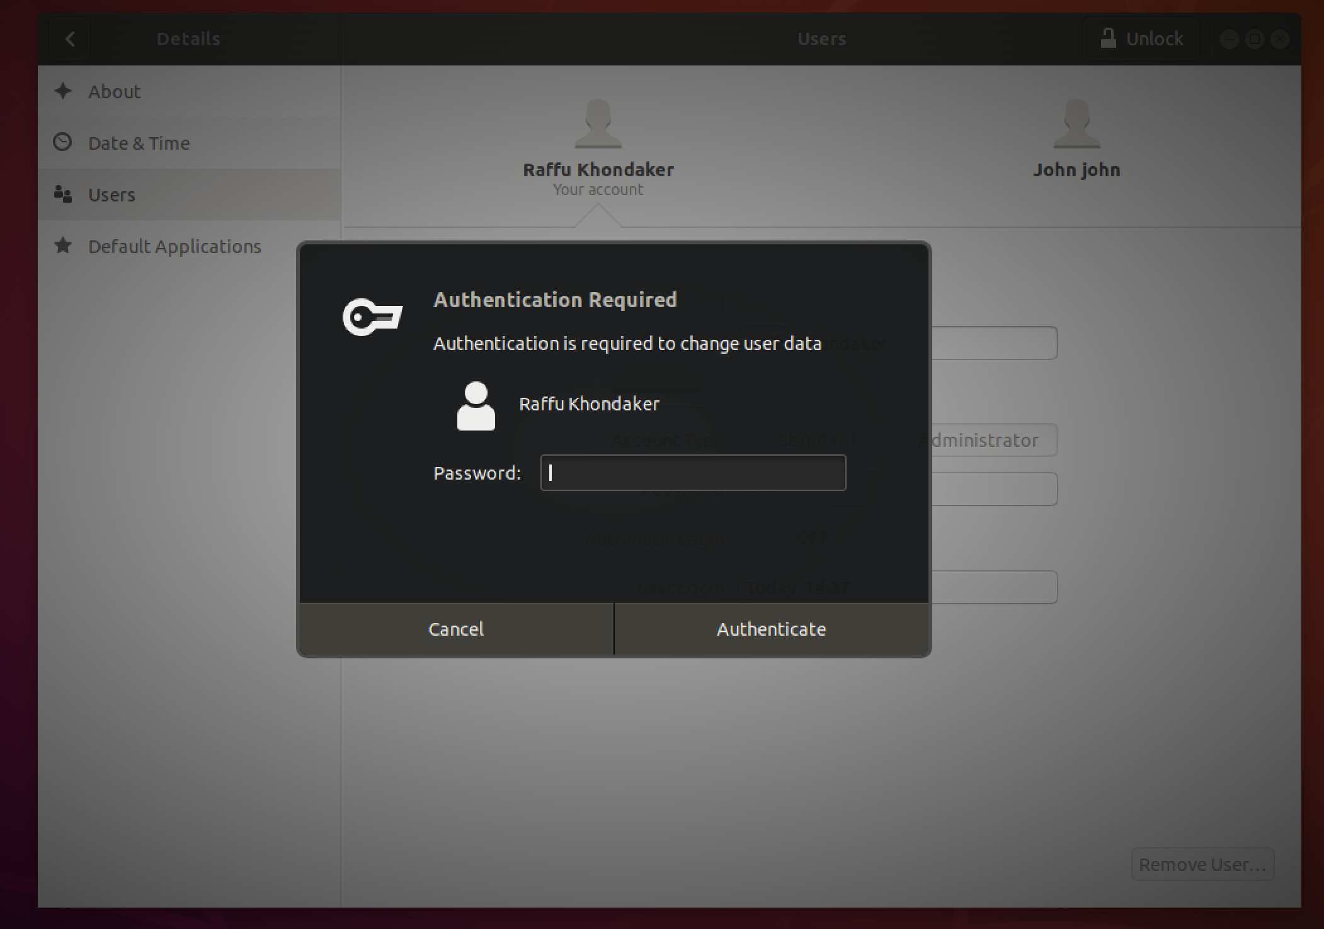
Users / Root
Regular Users: normal account, limited access
Groups: organize users, manage permissions
Admin accounts can access root
Root: administrative account, full access
Run all commands, access all files
Warning: easy to cause damage!
Require password
Are authorized to do something, but must authenticate (password) first
“sudo”

Slide 9
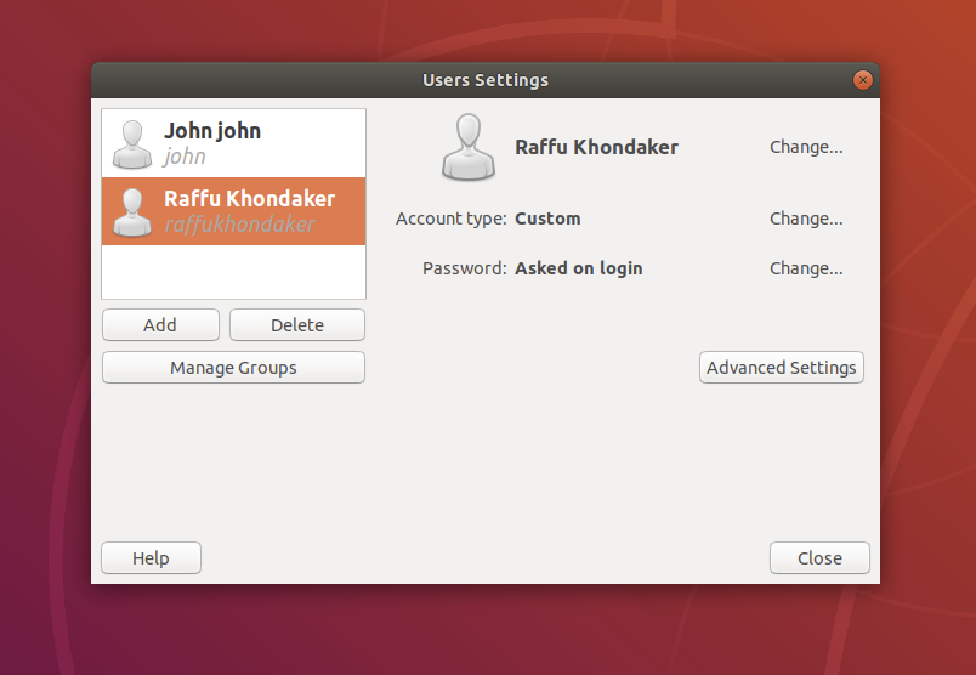
Users/root
Gnome system tools (slightly better GUI)

Slide 10
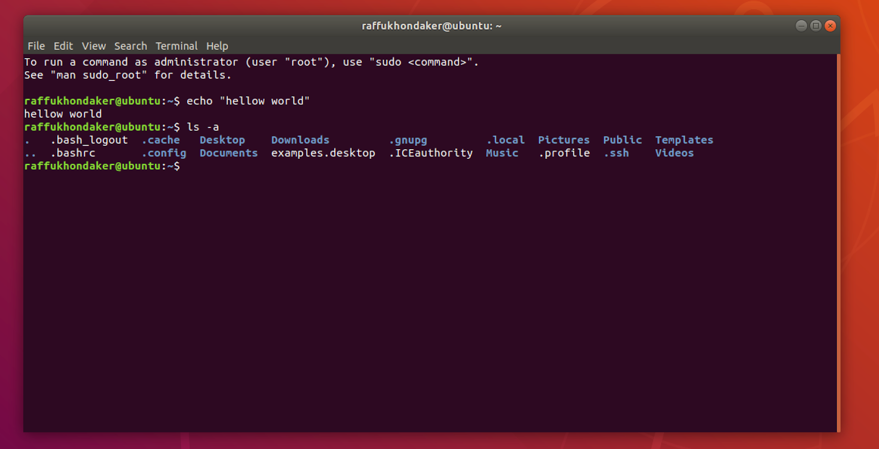
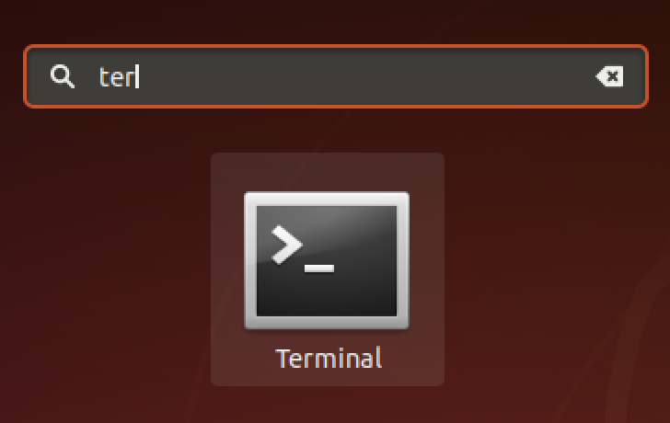
Command Line
Text interface to computer
Terminal on Linux
Basic usage
Type command
enter to run
Ctrl C to interrupt

Slide 11
Common Commands
ls - list files in directory
ls documents
cd - change directory
cd documents
cp - copy files or directories
cp file.txt file2.txt
cat - display file contents
cat file.txt
grep - search string in file
find - search for files with pattern
sudo - access root
passwd - change/set password
sudo apt install - install packages
sudo apt install git

Slide 12
More Commands!
https://docs.google.com/document/d/1FvBk8Kuh0P42LGRxihjducVipcnYqMWaXIc7vQYe2jQ/edit

